Slide 1
Communication Etiquettes
Presented By Group 10

Slide 2
Group members
Atharva Bhor
Subodh Surwade
Gaurav Jondhale
Anuj Kamble
Ritesh Rathod

Slide 3
Table Of Contents
Communication Etiquette and Importance of Communication.
Types of Communication.
How to improve communication and helpful books about communication.
Legends and how this presentation topic helped us.

Slide 4


What is Communication Etiquette?
Etiquette are the set of rules or customs that control accepted behavior in particular social groups or workplaces.
This Photo by Unknown Author is licensed under CC BY

Slide 5
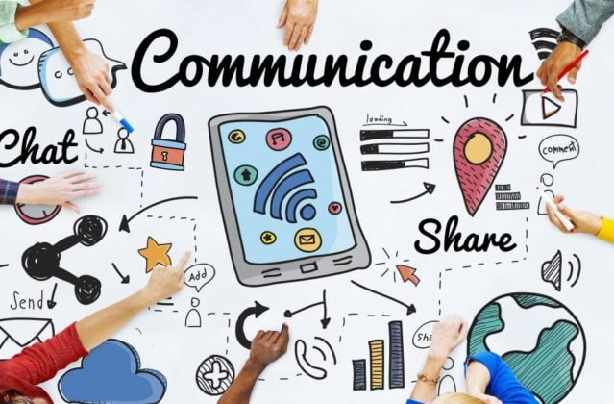
Types Of Communication.
Face to Face Communication
Text Communication
Telephone Communication
Email Communication

Slide 6

Face to Face Communication
Keep Eye contact
Listen carefully
Take interest
Be polite

Slide 7

Text Communication
Avoid using Multiple Languages
Keep it short and informative
Use courtesy words like sorry, thank you wherever needed
Avoid use of toxic language

Slide 8

Telephone Communication
Always start with a polite ‘Hello’.
Let them complete what they are saying
Avoid use of sarcasm
Always wish your superiors while on call

Slide 9

Emailing
Use Sir/ Madam while addressing your superiors
Send only the information and documents asked
Keep it on point. Avoid making it long.

Slide 10

Importance of Communication
Helps to build a better relationship
Essential factor at Workplace
Builds a good image in front of seniors and colleagues

Slide 11

How to improve Communication?
By practicing Communication with friends and family
Observing the professionals
Asking elders for advice
Watching Ted Talks(recommended: Brene Brown)

Slide 12

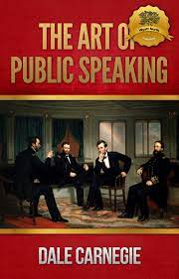
Some books

Slide 13
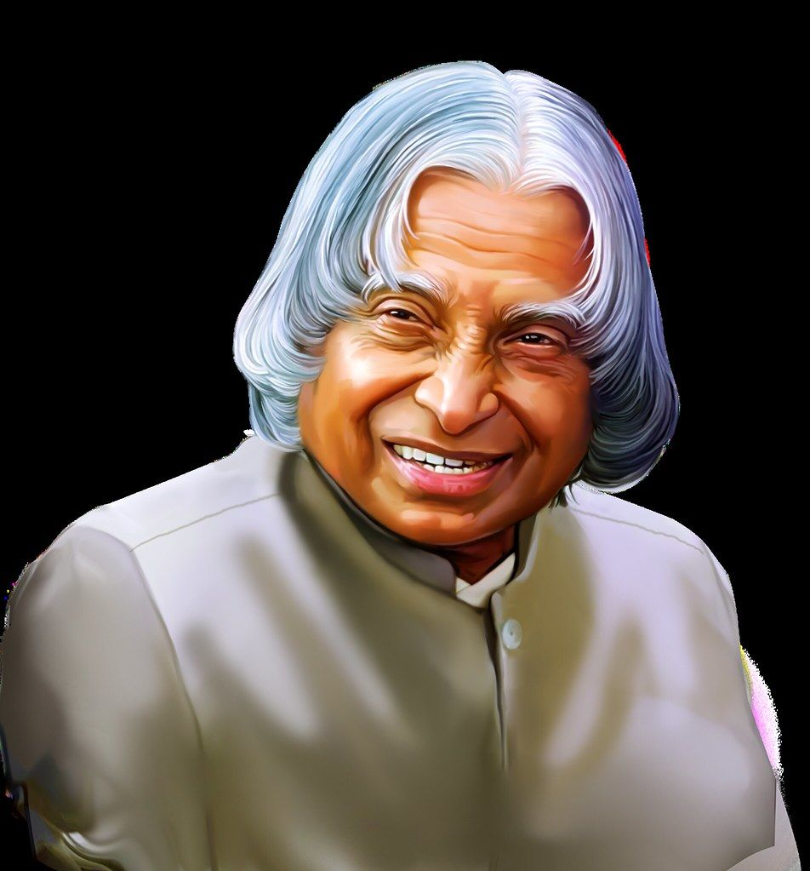
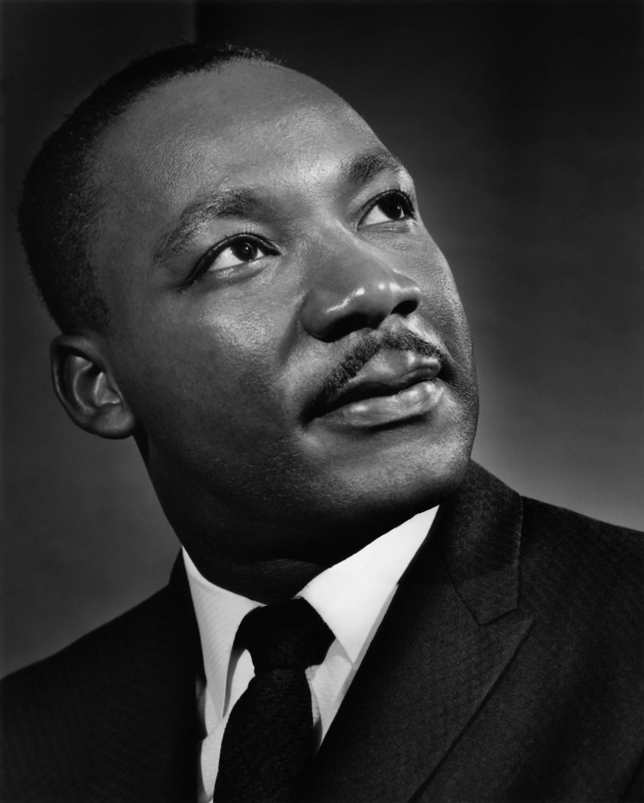
Legends

Slide 14
How this topic helped us

Slide 15
Thank You!!!!

